Slide 1


Slide 2

30 Days Data Scinece & Analytics Master Class
Day1 : Python for Data Science
Time: 6.00 PM IST
Free Registration

Slide 3
30 Days Data Scinece & Analytics Master Class
Handbook

Slide 4
NANDHINI.S
Exp: 5 Yrs
Expert in
Python Developer on Machine Learning
Deep learning with computer vision
Matlab – Image Processing
Autonomous Car design using ROS with LIDAR
Language – Python , Java , HTML ,CSS.
Tools – ANACONDA NAVIGATOR, JUPYTER NOTEBOOK,
GOOGLE COLAB.
Graduation : BE – ECE | 2011

Slide 5
Pantech?
Educational Equipment Manufacturer
IoT, AI, Robotics,Autonomous Robot
Microprocessor/Microcontroller
DSP,VLSI, Embedded System
Power Electronics & Drives, Fuel Cell Trainer Kit
Renewable Energy Lab, Electric Vehicle Lab
Technical Training
DIY Project

Slide 6

What is Master Class ?
👍 This is the 30 Days Industrial Learning Activity.
👍 Its Online YouTube Live Class
👍 If you Invest 45 minutes daily, U will become Master in Data Science
👍 You will get FREE E-Certificate
Webinar Participation Certificate
“Learning is the beginning of wealth.
Searching & Learning is where the miracle process all begins.” …………….Jim Rohn

Slide 7
Our Vision
Help 10 Million Students to Learn the Technology in Easy Way

Slide 8

Associate Partner for this Master Class
https://apssdc.in/home/

Slide 9
What U will Learn from 30 Days Data Science & Analytics Master Class

Slide 10
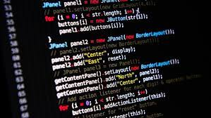




Data Science & Analytics Learning Plan
01
02
03
04
05
Library
Python
Analytics
Tools
Industry Project
Introduction To Python and Python Data Structures
Pandas
Numpy
MatplotLib
Cborn, SKLearn Lib
Collab
Distribution
Visualization
Aggregation
Statistics
PowerBi
Tableo
Project Building,
DSA Jobs

Slide 11
Day wise Learning Plan
Day -1 : Python for Data Science (5 Solved end-to-end Data Science Projects in Python)
Day -2: Advanced Python Programming
Day -3: Pandas Library – Introduction
Day -4: Pandas Library – Data Structures
Day -5: Numpy library – Array Operations | Mathematical Functions
Day -6: Numpy – Sort, Search and Counting Functions
Day -7: Matplotlib , Histogram Using Matplotlib | I/O With Numpy
Day -8: Matplotlib Library – Introduction , Pyplot API | Types Of Plots
Day -9: Seaborn Library
Day -10: SKLearn Library
Day -11: Google Colab Notebook
Day -12: Python – Date and Time, Data Wrangling
Day -13: Python – Data Aggregation
Day -14: Python – Word Tokenization , Stemming and Lammetization
Day -15: Python – Data Visualization

Slide 12
Day wise Learning Plan
Day -16: Python – Statistical Analysis
Day -17: Python – Types Of Distribution
Day -18: Python – Correlation ,Chi-Square Test , Linear Regression
Day -19: Tableau – Introduction and Tools
Day -20: Tableau – Data Sources , Worksheets
Day -21: Spatial Data Science For Covid-19 Disease Prediction
Day -22: Power-BI – Introduction, Installation Steps and Architecture
Day -23: Power-BI – Data Modelling , Visualization Options | Excel Integration
Day -24: Parkinson’s Disease Prediction – XG Boost Classifier
Day -25: House Price Prediction using Random Forest Regression
Day -26: Customer Segmentation Using ML – K-Means Clustering
Day -27: Home Loan Prediction using Decision Tree Classifier
Day -28: Spam Classification using NLP
Day -29: Hand Written Digit Recognition Using CNN
Day -30: Churn Prediction using Deep Learning

Slide 13
List of Projects for Demo in YouTube Live
Spatial Data Science For Covid-19 Disease Prediction
Parkinson’s Disease Prediction-XGBoost Classifier
House Price Prediction-Random Forest Regression
Customer Segmentation Using ML-K-Means Clustering
Home Loan Prediction-Decision Tree Classifier
Spam Classification-NLP
Hand Written Digit Recognition Using Python-CNN
Churn Prediction-Deep Learning
Crop Yield Prediction
Ground water level prediction
All Projects in Jupyter Notebook

Slide 14
What you will get from this Free 30 Days Master Class?
You can attend YouTube Live Class
Free E-Certificate ( WEBINAR PARTICIPATION CERTIFICATE)

Slide 15
How to mark your Attendance in YouTube Live Class?
Ans : During the Live Class, organizer will post Google Form link in Live Chat. The Participants should submit the from on daily basis. Minimum 25 Days Attendance is Required to get Free Master Class Participation Certificate.
Note : The Link will be available during the Live. From the LIVE Class date, the live video will get removed from the YouTube in 3 days.

Slide 16


Sample Webinar Participation Certificate?

Slide 17
https://www.pantechelearning.com/data-science-master-class/
On Demand
You can get chance to apply 1 Month Internship on Data Science & Analytics Master Class

Slide 18
What is Internship????
Learn
Practice
Verify
Get Certified
Grow

Slide 19
Free Master Class DSA | 1 Month Internship on DSA
Master Class Participation Certificate | Internship Completion Certificate
Minimum 25 Class should attend YouTube Live | Recorded Class Link will be provided. – LMS Portal Access
YouTube Live Mandatory | Your Choice. You can attend Live or else You can watch Recorded Class in LMS Portal
All Projects Demo class in YouTube Live | Step by Step Video Explanation Content in LMS Portal
Access : 3 Days | VIP WhatsApp Group Support
 | You Can Download All PPTs
 | 4 Nos of Hackathon Class in Zoom Live. The Recording also will be provided
 | You Can Download All Project Files
 | Mentor will guide you to finish 10 Projects
 | Access : 60 Days

Slide 20
Pantech will make you to Create 10 Projects in Data Science & Analytics in 30 Days
Objective of this 30 Days Master Class

Slide 21
1 Month Internship in Data Science
INTERNSHIP E-Certificate(30Days Internship on Data Science Engineering)
Highly organized Video content
Download All Files
Download PPTs
Assignments
Flexible Time.
Access Period: 60Days from the date of payment

Slide 22
What You Will Get???
Complete Project Files
30 Days Learning Activity
Data Science Core Concepts
10 + Projects
Project PPT
Spatial Data Science For Covid-19 Disease Prediction
Parkinson’s Disease Prediction-XGBoost Classifier
House Price Prediction-Random Forest Regression
Customer Segmentation Using ML-K-Means Clustering
Home Loan Prediction-Decision Tree Classifier
Spam Classification-NLP
Hand Written Digit Recognition Using Python-CNN
Churn Prediction-Deep Learning
Crop Yield Prediction
Ground water level prediction
Video Class Access for 2 Months
Get chance to Enroll 1-Month Internship on demand

Slide 23

How to join in 1 month Internship
https://www.pantechelearning.com/data-science-master-class/
Click Here
Coupon Code: DSABATCH4

Slide 24


Slide 25
Artificial Neural Networks:
The popular approach of using deep learning is using “Artificial Neural Network”.
They behave similar to human brain which is the most complex organ of our body.
Human Brain is made up of several billion tiny cells called neurons.
Neurons are connected to one another through nerve fibre called “axons” and “dendrites”.
Axon is used to pass the information from one neuron to another to which it is connected.

Slide 26
Artificial Neural Networks:
Dendrites are used to receive the information being transmitted by the axon of another neuron to which it is connected.
Each neuron process the small information, passes the result to another neuron and then this process continues.
This method is used by the human brain to process huge amount of information like text,visual etc and extract essential information from it.

Slide 27
Artificial Neural Networks:
Based on the human brain model , first artificial neural network (ANN) was invented by psychologist,Frank Rosenblatt in the year 1958.
Artificial neural networks are made up of multiple nodes which are similar to neurons.
Nodes are tightly packed and grouped into different hidden layers.
Finally , the output layer predict something useful about the input data.
For eg , the input is an image and the output is something identified in an image like “lion”.

Slide 28
Artificial Neural Networks:
A single neuron is called as a perceptron in artificial neural networks(ANN).
It contains
Multiple inputs along with weights which represent dendrites.
Sum of inputs along with activation function represents neurons.
Sum is nothing but the computed value of all inputs.
Activation function represent a function which modify the sum value to 0,1 or 0 to 1.
Actual output represent axon and output will be received by the neuron in the next layer.

Slide 29
Different Types Of ANN:
Multi-Layer Perceptron:
It is a basic form of ANN(Artificial Neural Network).
It consists of a single input layer , one or more hidden layer and an output layer.
Each layer consists of a collection of perceptron.
Input layer is nothing but one or more features of input data.
Every hidden layer consists of one or more neurons .
They process certain aspect of the feature and send the processed information into next hidden layer.
The output layer process receives the data from the last hidden layer and finally output the result.

Slide 30
Convolutional Neural Network(CNN)
It is one of the most popular Artificial Neural Network(ANN).
It is used in the fields of image and video recognition.
It is based on a maths concept called convolution.
It is same like multi-layer perceptron .
The only difference is that it contains a series of convolution layer and pooling layer before a fully connected hidden neuron layer.

Slide 31
Layers Of Convolutional Neural Network:
It contains three important layers.
Convolution Layer : It is the basic building block and perform computational tasks based on convolution function.
Pooling layer: It is stacked next to the convolution layer.
It is used to reduce the size of inputs by removing unwanted information so that computation can be performed faster.
Fully Connected Layer: It comes next to the series of convolution and pooling layer.
It classifies inputs into various categories.

Slide 32
CNN Representation:
2 series of convolution and pooling layer is used and it receives and process the input(eg:image).
A single fully connected layer is used and it is used to output the data(eg:classification of image).

Slide 33
Recurrent Neural Network(RNN)
They are used to address the flaw in many artificial neural networks(ANN).
ANN don’t remember the steps from previous situations.
They make decisions based on context in training.
RNN stores the past information and they make decisions based on what they have learnt from the last.
This kind of approach is used in image classification.
Bidirectional RNN is used to learn from the past and predict the future.
We can have handwritten samples in multiple inputs.

Slide 34
Recurrent Neural Networks(RNN)
Suppose , if one input doesn’t provide the desired result , then we have to check for other inputs.
We need to find the correct context which takes decision from the past.

Slide 35
ANN – Working Process
Following are the various steps involved in deep learning.
Keras can be helpful in the process of deep learning.
Gather the Required Data:
Deep learning requires a lot of data to learn and predict the results.
Collect as much data as possible.

Slide 36
ANN – Working Process
An algorithm includes one or more layers. Each layer in ANN can be represented by Keras layer.
Prepare Data – Process the data, filter the data and select only the essential information.
Split Data – Split the data into training and test data set.
Test data is used to measure the prediction of the algorithm.
It is used to cross check the efficiency of the learning process.
Compile the Model: Compile the algorithm or model.
The model learns itself by training and then it will make the prediction.

Slide 37
ANN – Working Process:
Evaluate Model : The model’s performance is measured by predicting the output for test data and the prediction result is compared with the actual result of the test data.
Freeze or choose new Algorithm: We need to check if the performance of the model is good.
If the performance is good , we can save the algorithm for future purpose.

Slide 38
ANN – Working Process:
If the performance is not good, then we need to choose a different algorithm .
We need to train, predict and then evaluate the model.
Repeat the process until the best algorithm is found.

Slide 39
CONVOLUTIONAL NEURAL NETWORK(CNN)

Slide 40
CNN:
Convolutional Neural networks are same as the ordinary neural networks.
CNNs are made up of neurons that have weights and biases.
Ordinary neural networks ignore the structure of input data.
The data is converted into 1D array before feeding it to the network.
This process is suitable for regular data.
If the data contains images , it may be a more difficult process.
This process can be solved easily by CNN.
The 2D structure of the images is considered while processing the images.
CNN allows to extract the properties specific to images.
The main aim of CNN is to go from raw image data in the input layer to the correct class in the output layer.
The difference between a neural network and CNNs is in the way how they treat the input data .

Slide 41
CNN – Architecture:
Normal neural networks receive an input and transform it through a series of hidden layers.
One layer is connected to other layer with the help of neurons.
One of the main disadvantages of normal neural networks is that they do not scale well to full images.
They have neurons arranged in 3 dimensions called width , height and depth.
Each neuron in the current layer is connected to a small patch of output from the previous layer.
We are overlaying an N*N filter on an input image.
It uses M filters to get all the relevant details.
These M filters are feature extractors which extract features like edges , corners etc.

Slide 42
Layers To Construct CNN:
Input Layer – It takes the raw image data.
Convolutional layer – It is the core building block of CNN and it does most of the computations.
It computes the convolution between the neurons and various patches in the input.
Rectified Linear Unit Layer – It applies an activation function to the output of previous layer.
It adds non-linear features to the network so that it fits well to any type of function.
Pooling Layer- It helps us to keep only the important parts as we proceed through the network.
This layer operates independently on every slice of input.

Slide 43
Layers To Construct CNN:
It resizes it spatially and uses the MAX function.
Fully Connected Layer or Output Layer:
This layer computes the output scores in the last layer.
The final output is of the size 1*1*L, where L is the number of training dataset classes.

Slide 44
CNN:
It is a feed-forward neural network .
It is used to analyze the visual images by processing the data with grid – like topology.
It is also called as ConvNet.
A CNN is used to detect and classify objects in an image.
Following is an example of neural network that identifies two types of flowers.

Slide 45
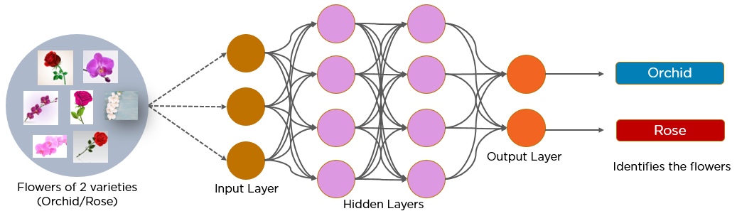
CNN - Image

Slide 46
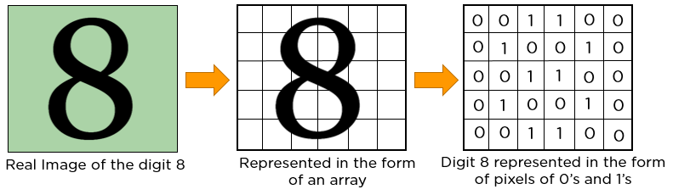
CNN – Image Represntation

Slide 47
CNN – Image Represntation
The convolution operation forms the basis of any convolutional neural network.
Consider two matrices a and b.
A = [5,3,7,5,9,7]
B = [1,2,3]
In the convolution operation , the arrays are multiplied element –wise and the product is summed to create a new array, a*b.
The first three elements of matrix a are multiplied with matrix b.
The product is summed to get the result.

Slide 48
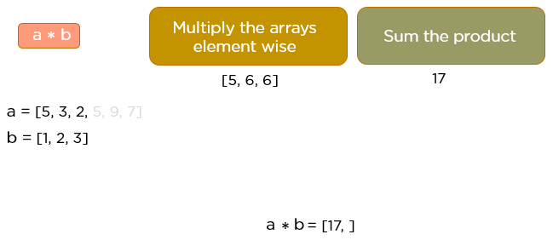
CNN – Image Representation

Slide 49
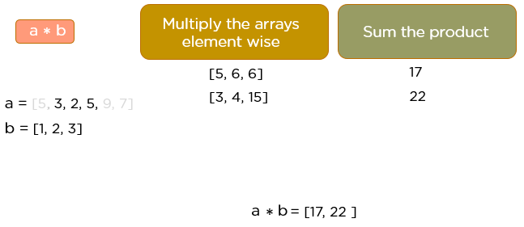
CNN – Image Representation
The next three elements from matrix a are multiplied by the elements in the matrix b.
The product is summed up.

Slide 50
CNN – Image Representation
This process is repeated until the convolution operation is completed.

Slide 51
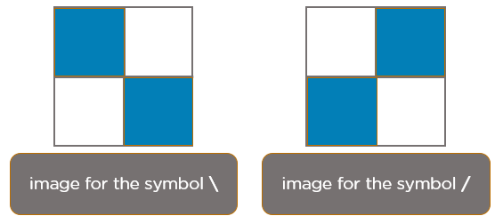
Image Recognition - CNN

Slide 52

Image Recognition - CNN
When you press backslash(\), the below image gets processed.

Slide 53

Image Recognition - CNN
When we press forward slash(/), the below image is processed.

Slide 54
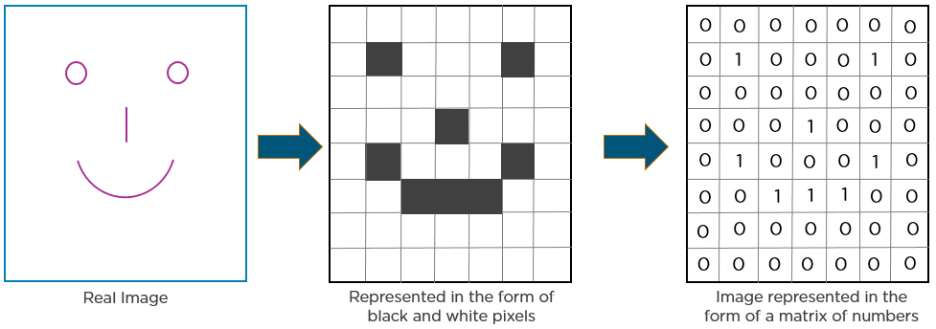
Image Recognition - Example

Slide 55
CNN - Layers
This step is used to extract some essential features from an image.
A convolution layer has various filters that perform the convolution operation.
Every image is considered as a matrix of pixel values.
Consider the following 5*5 image whose pixel values are either 0 or 1.
There’s also a 3*3 filter matrix.
Apply the filter matrix over the image and find the dot product to get the convolved feature matrix.

Slide 56
CNN - Layers
ReLU:
It stands for Rectified Exponential Linear Unit.
Once the features are extracted , the next step is to move them to a ReLU layer.
This operation operates on each element and it sets all the negative pixels to zero.
It introduces non-linearity to the network and the generated output is a rectified feature map.

Slide 57
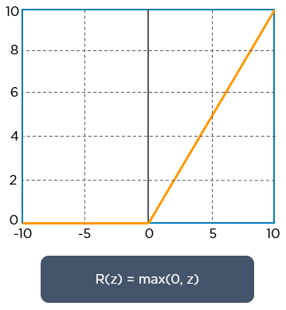
CNN - Layers

Slide 58
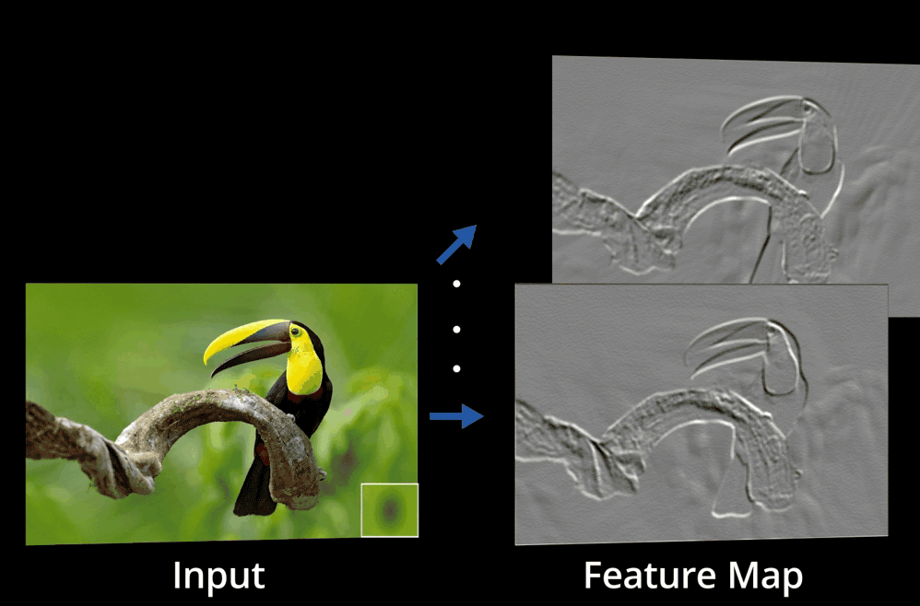
CNN - Layers
The original image is scanned with multiple convolutions and ReLU layers for locating the features.

Slide 59
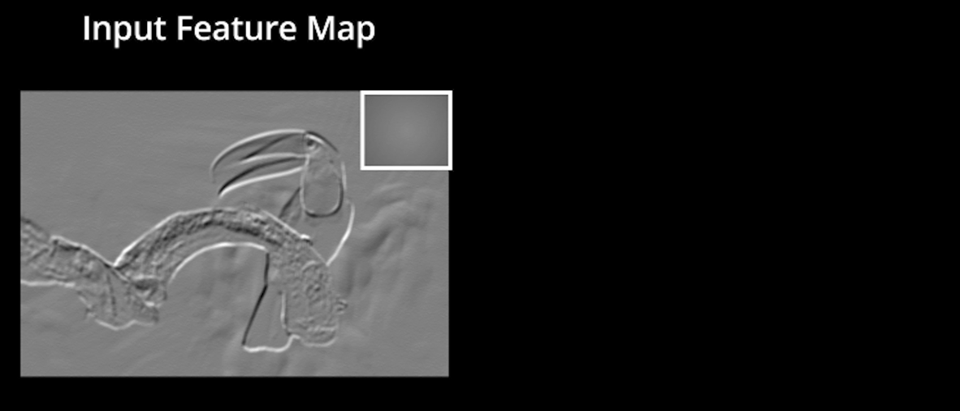
CNN - Layers

Slide 60
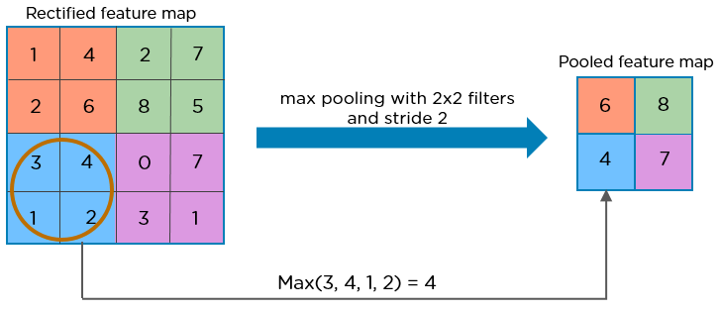
CNN - Layers
Pooling Layer:
It is a down – sampling operation that reduces the dimensionality of the feature map.
The rectified feature map goes through a pooling layer to generate a pooled feature map.

Slide 61
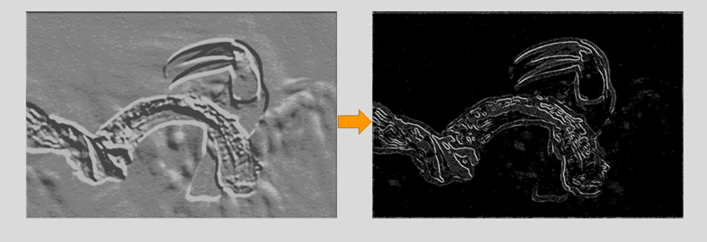
CNN - Layers
Pooling Layer:
The pooling layer uses various filters in order to identify different parts of an image like edges , corners , body , feathers , eyes and beak.

Slide 62
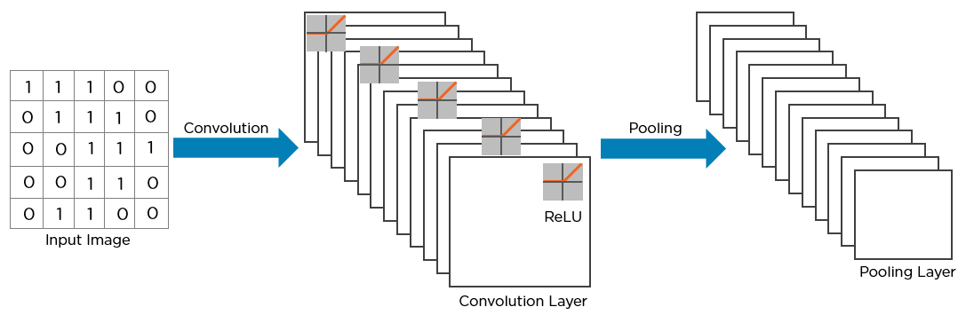
CNN - Layers
This is the structure of CNN:

Slide 63
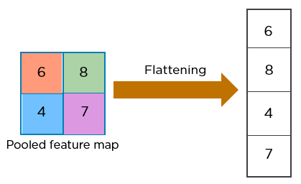
CNN - Layers
The next step in the process is called flattening.
This process is used to convert all the resultant 2 – Dimensional arrays from pooled feature maps into a single long continuous linear vector.

Slide 64
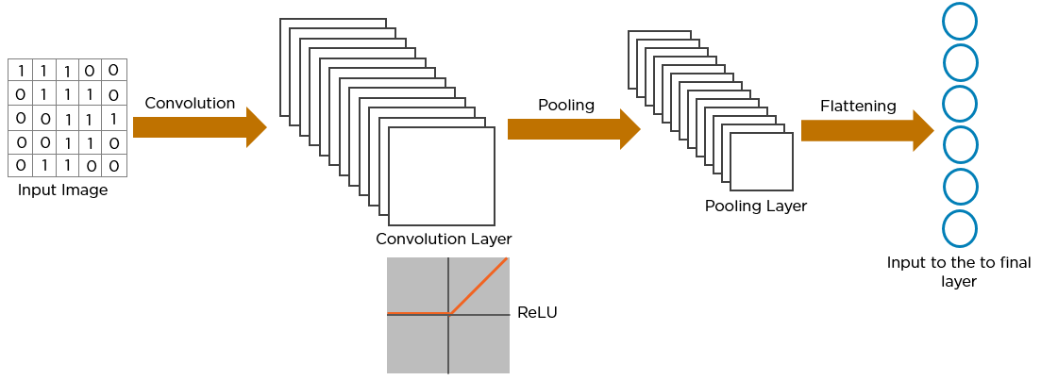
CNN - Layers
The flattened matrix is fed as input to the fully connected layer to classify the image.

Slide 65
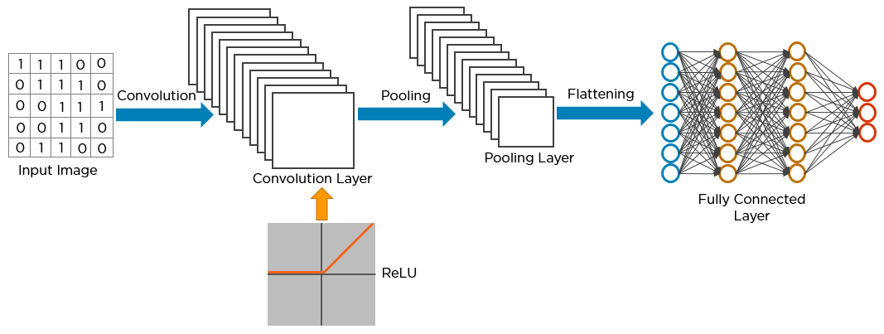
CNN - Layers

Slide 66
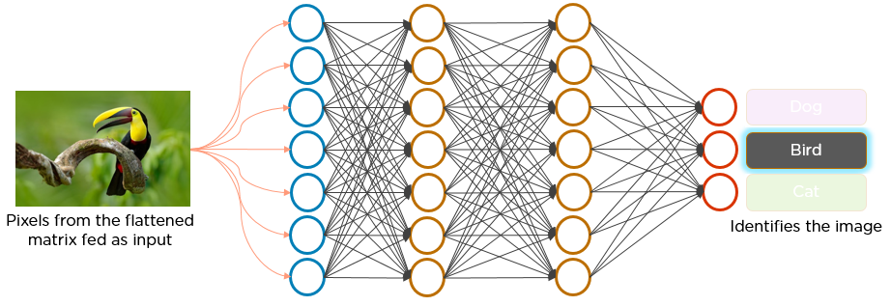
CNN - Layers

Slide 67
CNN - Layers
Steps to Recognize a bird using CNN:
The pixels from the image are fed to the convolutional layer that performs the convolution operation.
It results in a convolved map.
The convolved map is applied to the ReLU function to create a rectified feature map.
The image is processed with multiple convolutions and ReLU layers for locating the features.
Different pooling layers with various filters are used to identify the specific parts of the image.

Slide 68
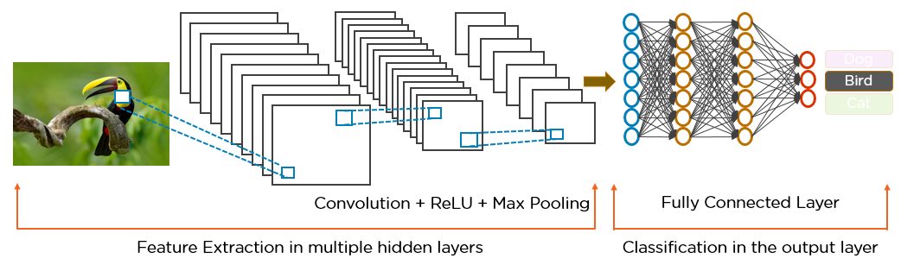
CNN - Layers
The pooled feature map is flattened and fed to a fully connected layer to get the final output.

Slide 69
PREDICTION USING CNN:
For our classification , we are going to collect the data from MNIST database.
It is nothing but a database of handwritten images .
MNIST is a collection of 60,000 28*28 grayscale images.
It contains 10 digits.
It also contains 10,000 test images.
The first step in any classification is that we need to design the model.

Slide 70
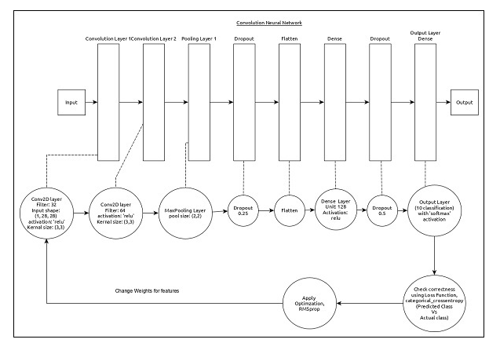
MODEL REPRESENTATION USING CNN:

Slide 71
FEATURES OF THE MODEL:
Input layer consists of (1,8,28) values.
First layer , Conv2D consists of 32 filters and ‘relu’ activation function with kernel size (3,3).
Second layer , Conv2D consists of 64 filters and ‘relu’ activation function with kernel size (3,3).
Third layer , MaxPooling has pool size of (2,2).

Slide 72
FEATURES OF THE MODEL:
Fifth layer , flatten is used to flatten all its input into single dimension.
Sixth layer , dense consists of 128 neurons and ‘relu’ activation function.
In the seventh layer , the dropout value is 0.5.
Eighth and final layer consists of 10 neurons and ‘softmax’ activation function.

Slide 73
FEATURES OF THE MODEL:
Categorical_crossentropy is used as the loss function.
Adadelta() is used as the optimizer.
Accuracy is used as the matrix.
Batch size is taken as 128.
The epochs is taken as 20.

Slide 74
STEP 1 – IMPORT THE REQUIRED MODULES
First , import all the essential modules.
import keras
from keras.datasets import mnist
from keras.models import Sequential

Slide 75
STEP 1 – IMPORT THE REQUIRED MODULES
from keras.layers import Dense, Dropout, Flatten
from keras.layers import Conv2D, MaxPooling2D
from keras import backend as K
import numpy as np
import tensorflow

Slide 76
Step 2: Load the data
Import the MNIST dataset.
(x_train, y_train), (x_test, y_test) = mnist.load_data().
Step 3: Process the Data.
Change the dataset according to the model , so that it can be fed into the model.
img_rows, img_cols = 28, 28
if K.image_data_format()=='channels_first':
x_train=x_train.reshape(x_train.shape[0],1,img_rows,img_cols) x_test=x_test.reshape(x_test.shape[0],1,img_rows,img_cols) input_shape=(1,img_rows,img_cols)

Slide 77
Step 2: Load the data
else:
x_train = x_train.reshape(x_train.shape[0], img_rows, img_cols, 1)
x_test=x_test.reshape(x_test.shape[0], img_rows, img_cols, 1)
input_shape = (img_rows, img_cols, 1)

Slide 78
Step 3: Process the Data.
x_train = x_train.astype('float32')
x_test = x_test.astype('float32')
x_train /= 255
x_test /= 255
y_train = keras.utils.np_utils.to_categorical(y_train, 10)
y_test = keras.utils.np_utils.to_categorical(y_test, 10).

Slide 79
Step 3: Process the Data.
Data processing is similar to MPL model.
It is similar to MPL model except the shape of the input data and image format configuration.

Slide 80
STEP 4 : CREATE THE MODEL:
Create the actual model.
model = Sequential()
model.add(Conv2D(32, kernel_size = (3, 3), activation = 'relu', input_shape = input_shape))
model.add(Conv2D(64, (3, 3), activation = 'relu'))
model.add(MaxPooling2D(pool_size = (2, 2)))

Slide 81
STEP 4 : CREATE THE MODEL:
model.add(Dropout(0.25)) model.add(Flatten())
model.add(Dense(128, activation = 'relu'))
model.add(Dropout(0.5))
model.add(Dense(10, activation = 'softmax'))

Slide 82
STEP 5 – COMPILE THE MODEL
Compile the model using selected loss function, optimizer and metrics.
model.compile(loss=keras.losses.categorical_crossentropy, optimizer = tensorflow.keras.optimizers.Adadelta(), metrics = ['accuracy'])

Slide 83
STEP 6 – TRAIN THE MODEL:
Train the model using fit() method.
model.fit(
x_train, y_train,
batch_size = 128,
epochs = 12,
verbose = 1,
validation_data = (x_test, y_test) )

Slide 84
OUTPUT:
Train on 60000 samples, validate on 10000 samples Epoch 1/12
60000/60000 [==============================] - 84s 1ms/step - loss: 0.2687
- acc: 0.9173 - val_loss: 0.0549 - val_acc: 0.9827 Epoch 2/12
60000/60000 [==============================] - 86s
1ms/step - loss: 0.0899
acc: 0.9737 - val_loss: 0.0452 - val_acc: 0.9845 Epoch 3/12
60000/60000 [==============================] - 83s
1ms/step - loss: 0.0666
- acc: 0.9804 - val_loss: 0.0362 –val_acc: 0.9879 Epoch 4/12
60000/60000 [==============================] - 81s
1ms/step - loss: 0.0564
acc: 0.9830 - val_loss: 0.0336 - val_acc: 0.9890 Epoch 5/12
60000/60000 [==============================] - 86s
1ms/step - loss: 0.0472
acc: 0.9861 - val_loss: 0.0312 - val_acc: 0.9901 Epoch 6/12
60000/60000 [==============================] - 83s
1ms/step - loss: 0.0414
- acc: 0.9877 - val_loss: 0.0306 - val_acc: 0.9902 Epoch 7/12

Slide 85
OUTPUT:
60000/60000 [==============================] - 89s 1ms/step - loss: 0.0375
-acc: 0.9883 - val_loss: 0.0281 - val_acc: 0.9906 Epoch 8/12
60000/60000 [==============================] - 91s 2ms/step - loss: 0.0339
-acc: 0.9893 - val_loss: 0.0280 - val_acc: 0.9912 Epoch 9/12
60000/60000 [==============================] - 89s 1ms/step - loss: 0.0325
- acc: 0.9901 - val_loss: 0.0260 - val_acc: 0.9909 Epoch 10/12
60000/60000 [==============================] - 89s 1ms/step - loss: 0.0284
- acc: 0.9910 - val_loss: 0.0250 - val_acc: 0.9919 Epoch 11/12
60000/60000 [==============================] - 86s 1ms/step - loss: 0.0287
- acc: 0.9907 - val_loss: 0.0264 - val_acc: 0.9916 Epoch 12/12
60000/60000 [==============================] - 86s 1ms/step - loss: 0.0265
- acc: 0.9920 - val_loss: 0.0249 - val_acc: 0.9922

Slide 86
Step 7 – evaluate the model:
Evaluate the model using test data.
score = model.evaluate(x_test, y_test, verbose = 0)
print('Test loss:', score[0])
print('Test accuracy:', score[1])

Slide 87
Output:
Test loss: 0.024936060590433316
Test accuracy: 0.9922.
The test accuracy is 99.22% .
Using this model , the handwritten digits can be identified.

Slide 88
Step 8 – predict:
Predict the digits from images:
pred = model.predict(x_test)
pred = np.argmax(pred, axis = 1)[:5]
label = np.argmax(y_test,axis = 1)[:5]
print(pred)
print(label)

Slide 89
Output:
[7 2 1 0 4]
[7 2 1 0 4].
The output of both the array is identical .
It indicates that our model correctly predicts the first five images.

